Slide 1
The Blockchain realizes
Goodwill
Economy

Slide 2


- Facebook number of friends
- Twitter number of followers
Bullshit which make people kill the time

Slide 3

We create a new index
which make people much happier.
That’s “Goodwill”

Slide 4

We implement “Goodwill Economy” by Blockchain
- inrevisable ledger which makes value worthable
- system is supported by “ Miners ”
- for BITCOIN: computes to add the ledger
- for “Goodwill” : computes to add the ledger
and people who spread the Goodwill behavior

Slide 5

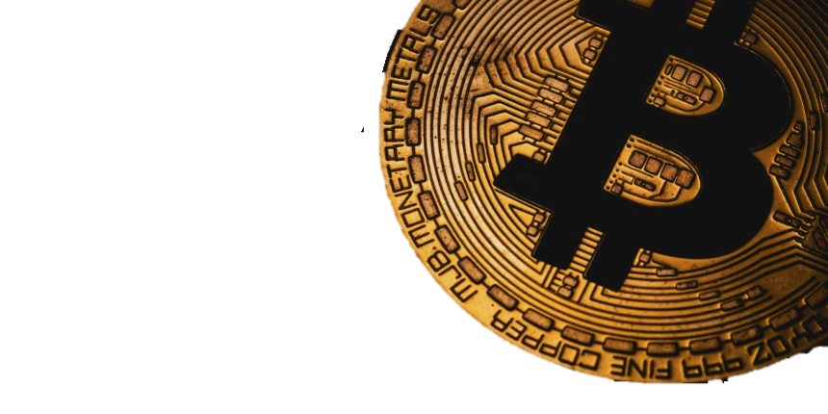
Difference
with BITCOIN
Goodwill is not like money,
That will not be lost
even you give the value to other
when you felt the Goodwill behavior by the person.
.

Slide 6
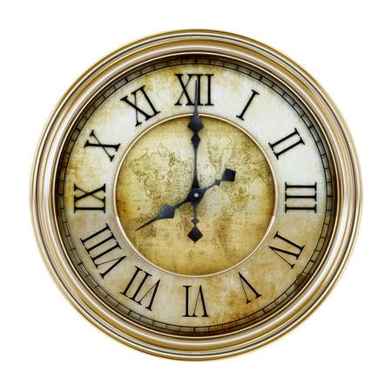
But we need to prevent worthless posts.
We consume the value temporary.
“Goodwill” is Recoverable value.
Important achievement
in Blockchain Research

Slide 7

DEMO
In the case you appreciated
Some persons goodwill

Slide 8
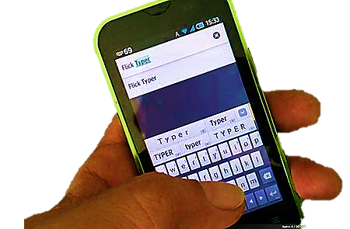
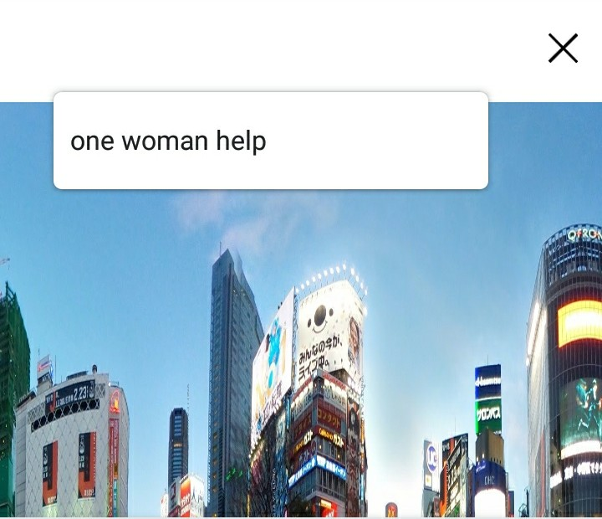
DEMO
Post the Goodwill
of what appreciated
with whom appreciated
even you cannot identify the person
you can identify later

Slide 9
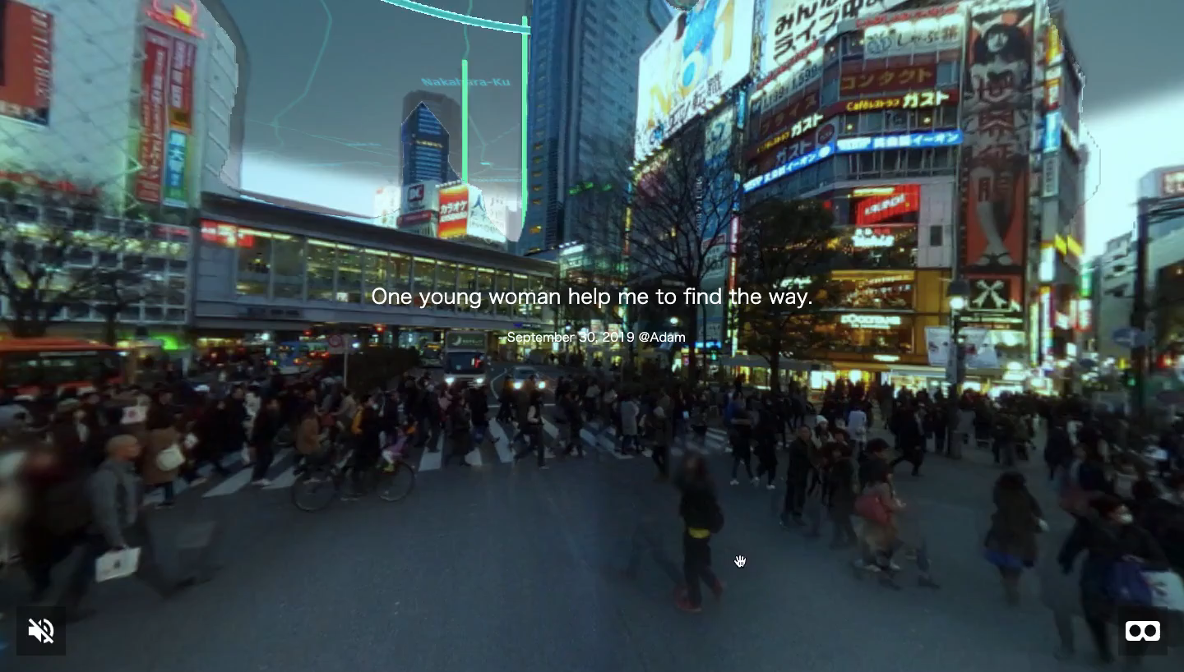
What makes the value more important:
“presence”
We utilize AR
to see the value
at where the Goodwill happen
We also utilize Deep Learning to detect the sky area.

Slide 10
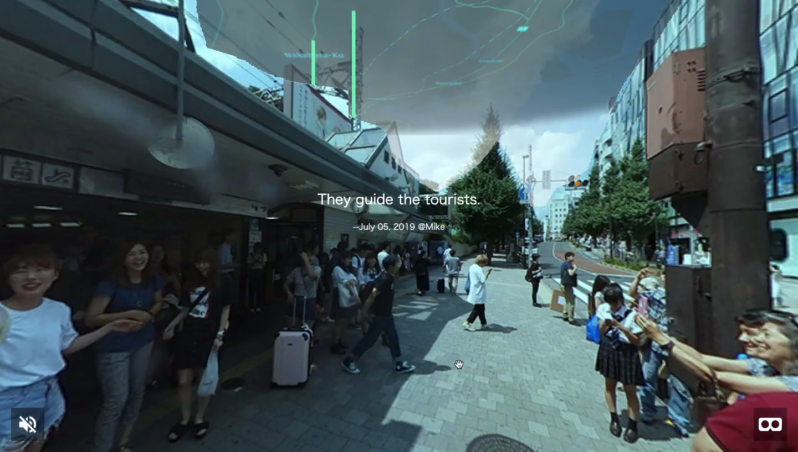
The post is recorded at the place.
People can find posts by seeing the view from the web.

Slide 11

And if people think that is worth spreading
They can post on any SNS.
That gains your value!

Slide 12
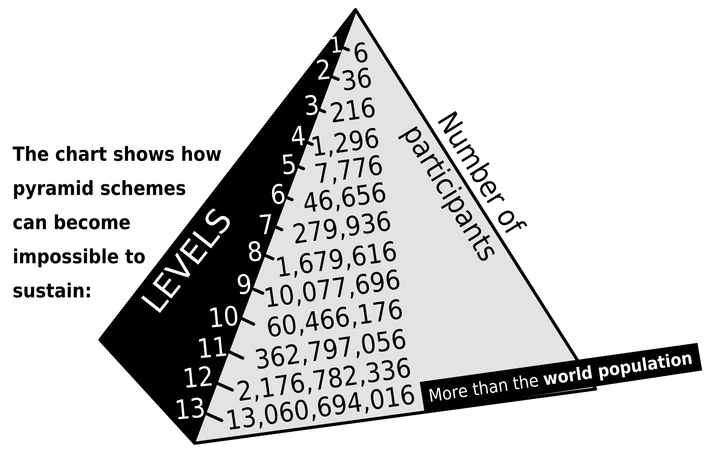
Early Spreading is boosted by
The
Pyramid
Scheme
for Goodwill
Counting the contribution of spreading
by the number of successors not only direct child.
It encourage spreading effectively.

Slide 13
The Blockchain realizes
Goodwill
Economy

Slide 15
System overview
Blockchain
Server
IBM cloud
Python
Posting UI
(Web Server)
Javascript
AWS
Web
Browser
Searching the Posts
Python
AR View
(Web server)
Javascript
A-FRAME
Glitch
HMD
Google
Street View
View Extracting
Module
Now.sh
Sky removing
Module
Algorythmia
HERE
MAP Extracting
Module

Slide 16
Blockchain records (Category: Basic)
Type JOIN: “UserA” is given “100”pt as joining initially.
The date is “15:12 June 29th, 2019”.
CONDITIONs) 1. “UserA” must not appear on previous records.
Type SEND: “UserB” is given “50”pt from “UserA” , and now
‘UserB’ has potential of “150”pt.
The place was “N123, E456”.
The comment was “One woman helps me to find the way.”
The date is “13:14 June 30th, 2019”.
CONDITIONs) 1. “UserB” can be “Unidentified Person”.
Type REVISE: The comment in the record post at “13:14 June 30th, 2019” is revised as
“Revised comment” by “UserC”
CONDITIONs) 1.”UserC” must be “UserA” or “UserB” on the denoted record.
Type IDENTIFY: Receiver of the record post at “13:14 June 30th, 2019” is identified as “User C”.
CONDITIONs) 1. The post denoted must contain “Unidentified Person” as the receiver
Common Conditions: 1. double quoted value is variables.
2. each User variables appear on the record must have a record Type JOIN.
3. single quoted value must be same variables appear on the record.
4. “UserA” in all records must be authorized by the system.

Slide 17
Blockchain records (Category: Advanced)
Type INTRODUCE: “Introducing User” is given 100pt for introducing “New User” as a new member.
The date is “16:04 June 30th, 2019”.
CONDITIONs) 1. “UserB” must appear on a previous record Type JOIN.
2. There is no other record Type INTRODUCE for same “New User”
but if there is a record Type INTRODUCE “New User” by “Successor User”
and the record Type INTRODUCE “Successor User” by “Introducing User”.
- it should be recursive … future task
- Could you notice this is the Pyramid Scheme for introduction!
- Also we should think about Pyramid Scheme for spreading the record Type SEND.

Slide 18
Example sequence
“point” will reduced when a person send it to other, but they keep “potential” and the “point” will recover in 24 hours after the time of last sent record.
Date1, UserA joined. Got 100pt.
Date2, UserB joined. Got 100pt.
Date3, UserA sent 50pt to UserB. (Here User A’s point reduced to 50pt. The value sent is always half point.
Now userB’s potential is 150, User B’s potential and value gain 50pt.
And the point is 150. Always receiver’s potential and point is calculated and record to
prevent calculate from all record.
Only last give moment gives farest information.
Potential is just added to last given record of UserB
How to calculate UserB’s point: see formula below. )
I revised to record both sender and receiver’s point when SEND happen.,
Current Point =
The point in last given or sent record
+ ( Potential appear in the last given or sent record
- The point in last given or sent record)
* Max ( 1, (current time – last sent time )/ 24 hours )

Slide 19
Example Sequence (cont’d)
Next record is added before sender UserA fully restored. UserA has 70/100 pt.
Date4, UserA send 35pt to UserB (UserA is still recovering.
Now UserB’s potential is 185 Before adding this record UserA’s point must be checked.
And UserB’s point is 185 Now UserB reduces its point from 70 to 35.
UserA’s potential is 100 You remember the sent is always half of the value.
and UserA’s point is 35 But time esteemed to recover is 24 hours after last sent,
so the speed is differ depend on how much the point is used.)
Next record is added before receiver UserA fully restored. UserA has 60/100 pt.
Date5, UserB send 93pt to UserA
Now UserA’s potential is 193,
And the point is 153. (UserA had 60pt at that time, and added 93 means 153.)
UserB’s potential is 185
and UserB’s point is 92.

Slide 20
How “Goodwill” appreciated:
- If a people do a thing which is appreciated by other.
- If a people contribute
to spread what was appreciated
That’s “Goodwill Economy”

